Slide 1
DSD PROJECT REPORT Metal Detector Car
Made by:
-Ahmed Ramadan
-Mohamed Youssef
-Abdallah Harly
-Fady Rezk

Slide 2
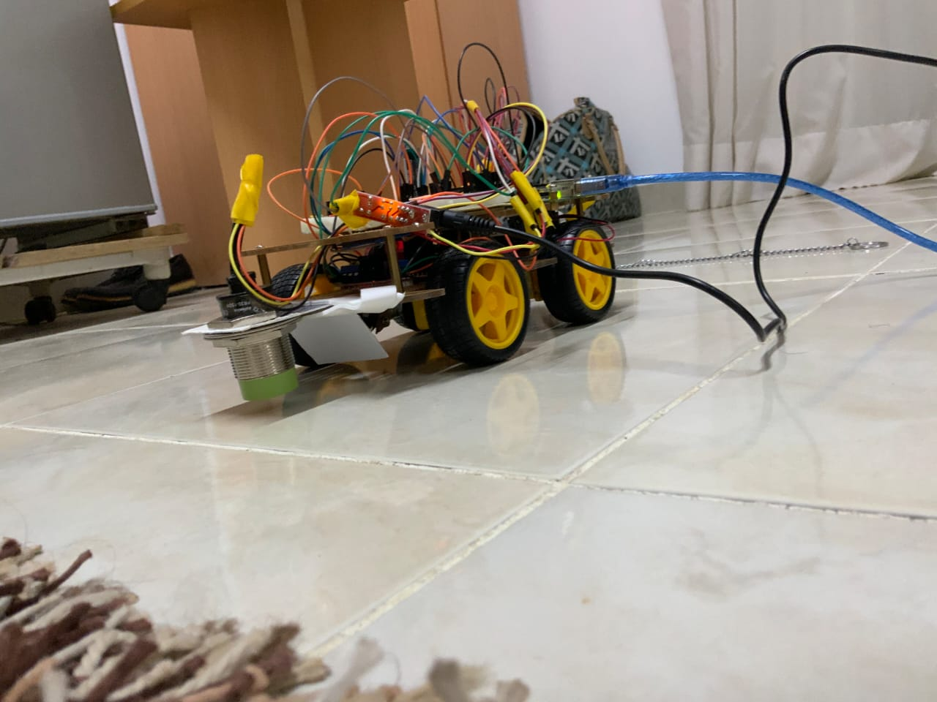

Slide 3
IDEA
The Project is a metal detector car that detects the presence of metal nearby. The car works with the following features:
1-Giving an indication about metals by giving an alarm using Inductive Proximity Sensor buzzer
2-It can predict if there is an obstacle in front it using Ultra Sonic Sensor

Slide 4
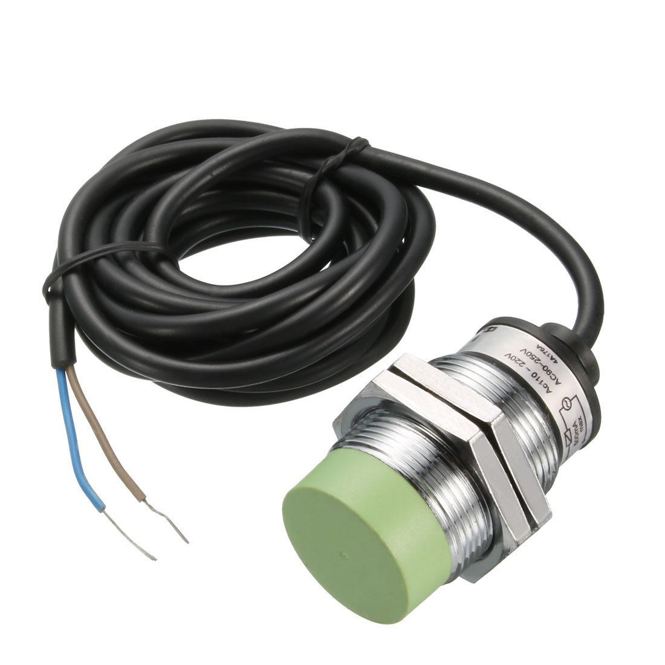
COMPONENTS
Inductive Proximity Sensor 15mm

Slide 5
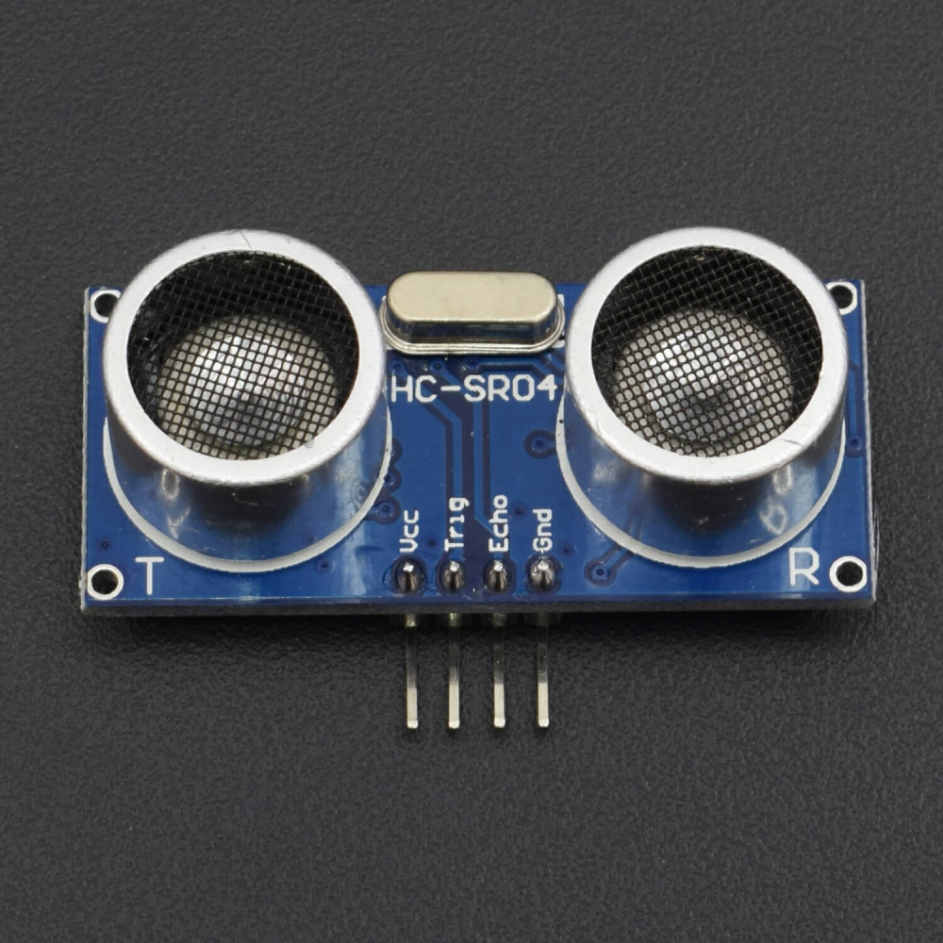
Ultra Sonic Sensor

Slide 6
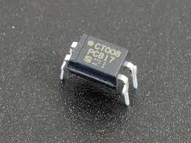
PC817

Slide 7
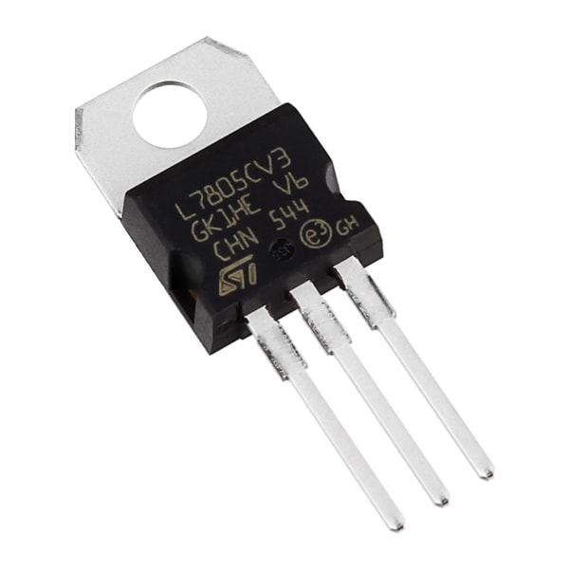
5V Regulator

Slide 8
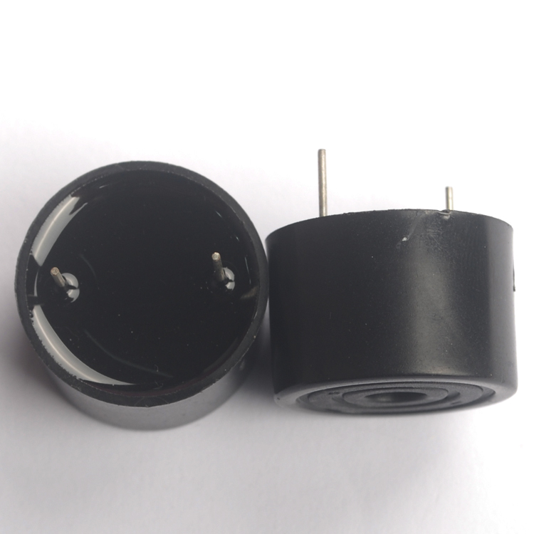
Buzzer 9V

Slide 9
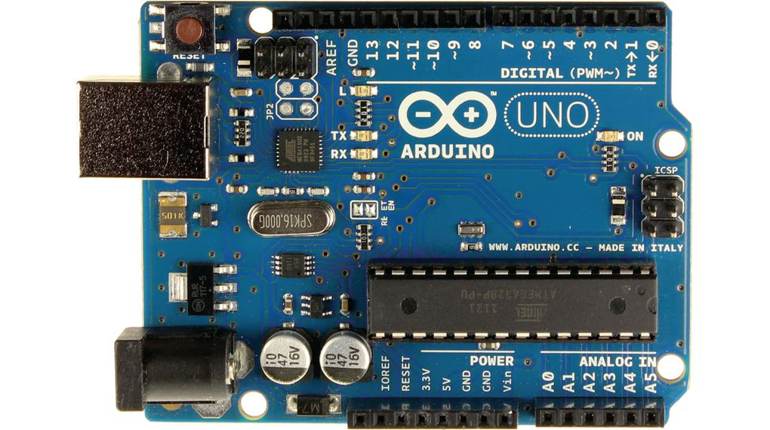
Arduino

Slide 10
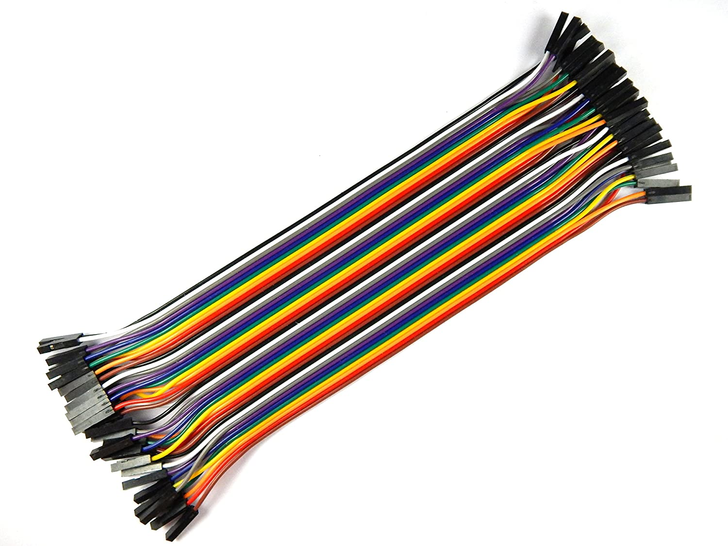
Jumper wires

Slide 11
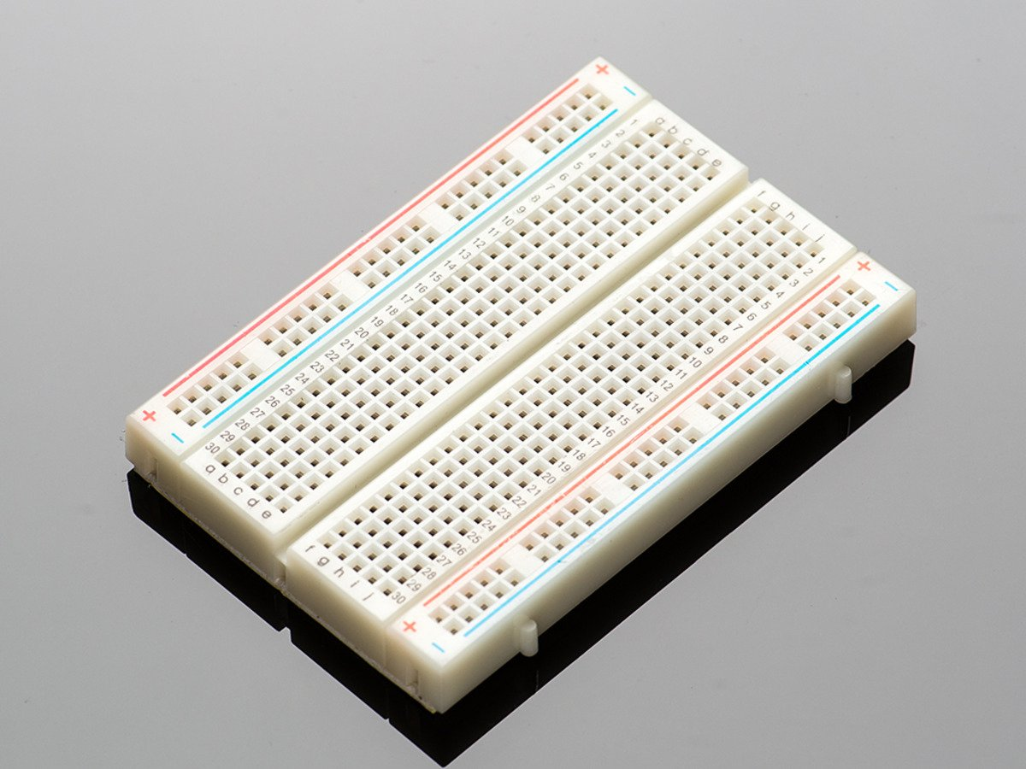
BreadBoard

Slide 12
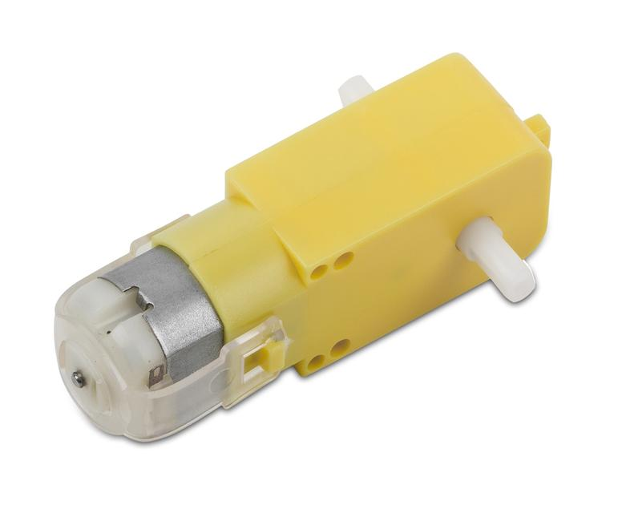
DC Motor

Slide 13
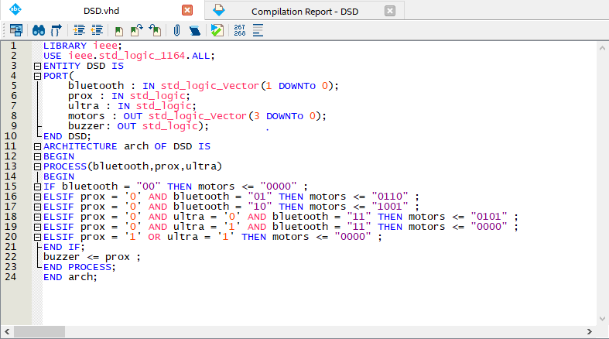
VHDL code

Slide 14
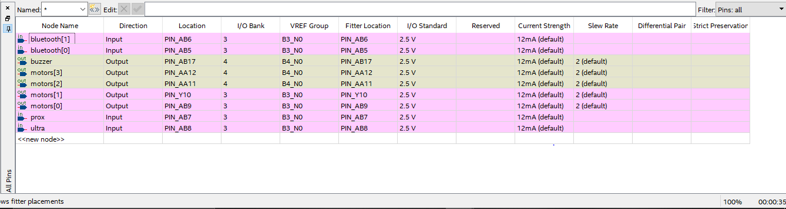
PINs assignment

Slide 15
Results
We designed a metal detector car that can detect metals by looking for it on the ground.
The inductive proximity sensor generates an electromagnetic field to sense metal objects passing close to its face and gives an alarm using Buzzer
The Ultra Sonic Sensor forces the car to stop if there is an obstacle in front of it.

